Slide 1


Othello: A Java Console Game
This project designs and implements a console-based Othello (Reversi) game using Java, applying core Object-Oriented Programming (OOP) concepts. It aims to provide an interactive and logical gameplay system for this classic strategy board game.
Notes:
1

Slide 2


The Problem: Manual Board Games
Physical Setup
Manual board games require tedious physical arrangement.
No Validation
Lack automatic rule validation, leading to errors.
No Score Calculation
Scores must be calculated manually, which is time-consuming.
Error-Prone
Manual play is prone to human errors and can be slow.
Notes:
2

Slide 3







The Solution: A Java-Based Othello
Automatic Validation
Player Turn Management
Validates moves, including diagonal and straight captures.
Automatically switches player turns for seamless gameplay.
Score Calculation
Calculates scores and declares the winner automatically.
Notes:
3

Slide 4







Project Overview: How it Works
The game follows a clear sequence of steps for interactive gameplay.
Enter Move
Validate Move
Flip Pieces
Update Board
Switch Turn
Notes:
4

Slide 5





Why Java for Othello?
Platform Independent
Runs on various operating systems without modification.
Supports OOP
Facilitates structured and modular code design.
Secure & Reliable
Known for its robust security features and stability.
Widely Used
A popular choice in the industry for diverse applications.
Notes:
5

Slide 6

OOP Concepts in Othello
1
2
Class and Object
Encapsulation
Represent game components like OthelloGame, Board, and Player.
Private variables and controlled access ensure data security.
3
4
Abstraction
Inheritance
Hides complex logic, allowing users to interact with a simple interface.
Promotes code reuse and structured game behavior.
5
6
Polymorphism
Control Structures
Methods adapt behavior based on context, e.g., move validation.
Loops and conditions manage turns and board updates.
Notes:
6

Slide 7
Implementation: Code Snippets
The core logic of the Othello game is implemented in Java, demonstrating key functionalities.
import java.util.*;
public class Othello6 {
static final int EMPTY = 0;
static final int BLACK = 1;
static final int WHITE = 2;
static final int SIZE = 6;
static final int[][] DIRS = {
{-1,-1}, {-1,0}, {-1,1},
{0,-1}, {0,1},
{1,-1}, {1,0}, {1,1}
public static class Board {
int[][] grid = new int[SIZE][SIZE];
public Board() {
initialize();
void initialize() {
for (int i = 0; i < SIZE; i++)
Arrays.fill(grid[i], EMPTY);
grid[2][2] = WHITE;
grid[2][3] = BLACK;
grid[3][2] = BLACK;
grid[3][3] = WHITE;
boolean inBounds(int r, int c) {
return r >= 0 && r < SIZE && c >= 0 && c < SIZE;
boolean isValidMove(int player, int r, int c) {
if (!inBounds(r, c) || grid[r][c] != EMPTY) return false;
int opp = opponent(player);
for (int[] d : DIRS) {
int i = r + d[0], j = c + d[1];
boolean foundOpp = false;
while (inBounds(i,j) && grid[i][j] == opp) {
foundOpp = true;
i += d[0]; j += d[1];
if (foundOpp && inBounds(i,j) && grid[i][j] == player) return true;
return false;
Notes:
7

Slide 8
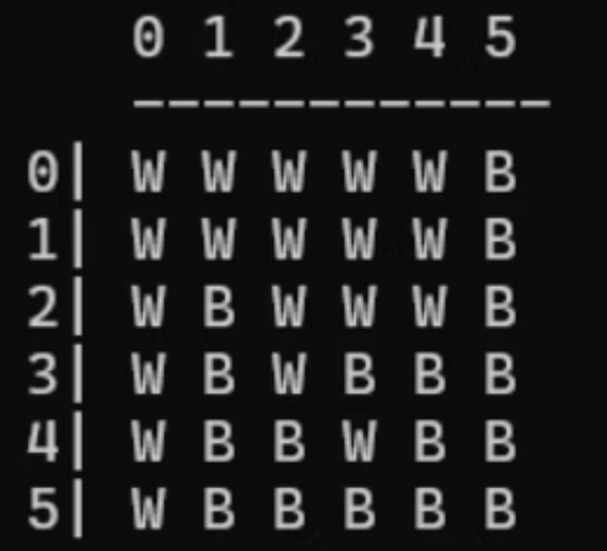
Game Result: White Wins!
A sample game demonstrates the console output, showing moves, board updates, and the final score.
Score -> Black: 17 White: 19
Game Over!
Final Score -> Black: 17 White: 19
White wins!
Notes:
8

